Slide 1
01
STACK DATA STRUCTURES
IN SMART CAR PARKING SIMULATION
VINAYAK KHANNA
24BCD10040

Slide 2



Introduction to Stack Data Structures
LIFO Principle
Stacks operate on a Last In, First Out basis, meaning the most recently added element is the first to be removed.
Push and Pop Operations
The two main operations are push (adding an element) and pop (removing an element) from the stack.
Dynamic Memory Allocation
Stacks can dynamically grow and shrink as elements are added or removed, optimizing memory usage
Use Cases in Programming
Stacks are commonly used in programming for function calls, expression parsing, and backtracking algorithms.
Memory Efficiency
Stacks utilize memory more efficiently by allocating space only when necessary, unlike static data structures.
Applications in Simulations
Stacks can enhance algorithms in simulations, such as optimizing smart car parking systems.

Slide 3

Smart Car Parking Systems Overview
Real-Time Monitoring
Sensors detect available spaces, guiding drivers efficiently.
Automated Payment Systems
Streamlined payment processes reduce wait times significantly.
Mobile Applications
Users can reserve spots and get notifications about availability.
Data Analytics
Analyzes parking patterns to improve space utilization over time
Reduced Traffic Congestion
Minimizes traffic caused by drivers searching for parking spots.
Lower Emissions
Decreases emissions associated with unnecessary driving in search of parking.
Enhanced Urban Mobility
Contributes to overall urban mobility by integrating technology.
Challenges Ahead
Exploring challenges and solutions for smart parking systems.

Slide 4




High Demand for Parking Spaces
Urban areas face a significant shortage of parking spots, causing driver frustration and congestion.
Time Wasted Searching for Spots
Drivers often spend excessive time looking for parking, worsening traffic conditions.
Inefficient Space Utilization
Many parking lots are underused due to poor management, leading to lost opportunities for efficiency.
Data Management Issues
Managing real-time data from sensors and apps can overwhelm traditional parking systems.
Challenges in Managing Parking Spaces
Exploring the complexities of parking management

Slide 5

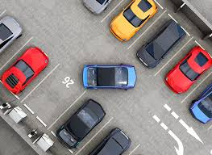
Efficient Parking Management with Stacks
Orderly Management of Parking
Stacks allow systematic addition and removal of cars, preventing chaos in busy areas.
Efficient Car Retrieval
The last car parked is the first to leave, optimizing space in limited areas.
Optimized Memory Usage
Stacks help in dynamically allocating parking resources based on real-time demand.
Reduced Error Rates
Minimizes retrieval errors, enhancing the reliability of smart parking systems.
➀
➁
➂
➃

Slide 6

Operation Used To Implement Parking
1. Park a Car
- Action: Adds a car to the parking lot.
- Logic: The car is pushed onto the stack.
3. Display Parking
- Action: Shows the current status of the parking lot.
- Logic: The program prints all elements in the stack from top to bottom.
2. Remove a Car
- Action: Removes a specific car from the stack.
- Logic:
- If the car is at the top, it's simply popped.
- If it's not on top, cars above it are temporarily popped and stored in another stack.
4. Exit
- Action: Ends the program.
- Logic: The user selects this option to terminate the menu-driven program safely.

Slide 7
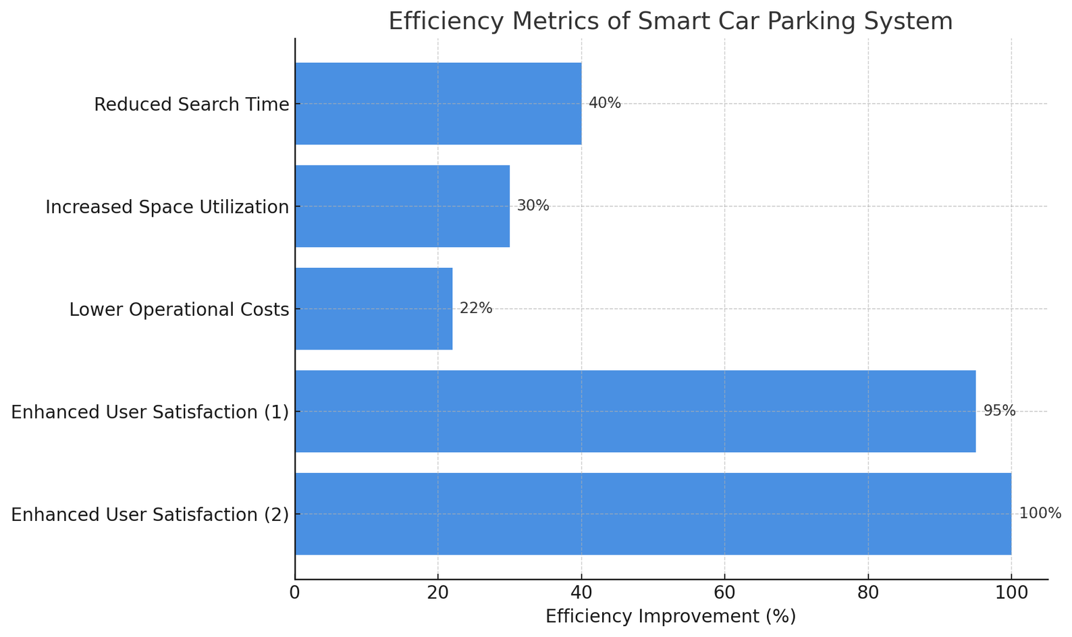
Efficiency Gains in Car Parking Management

Slide 8
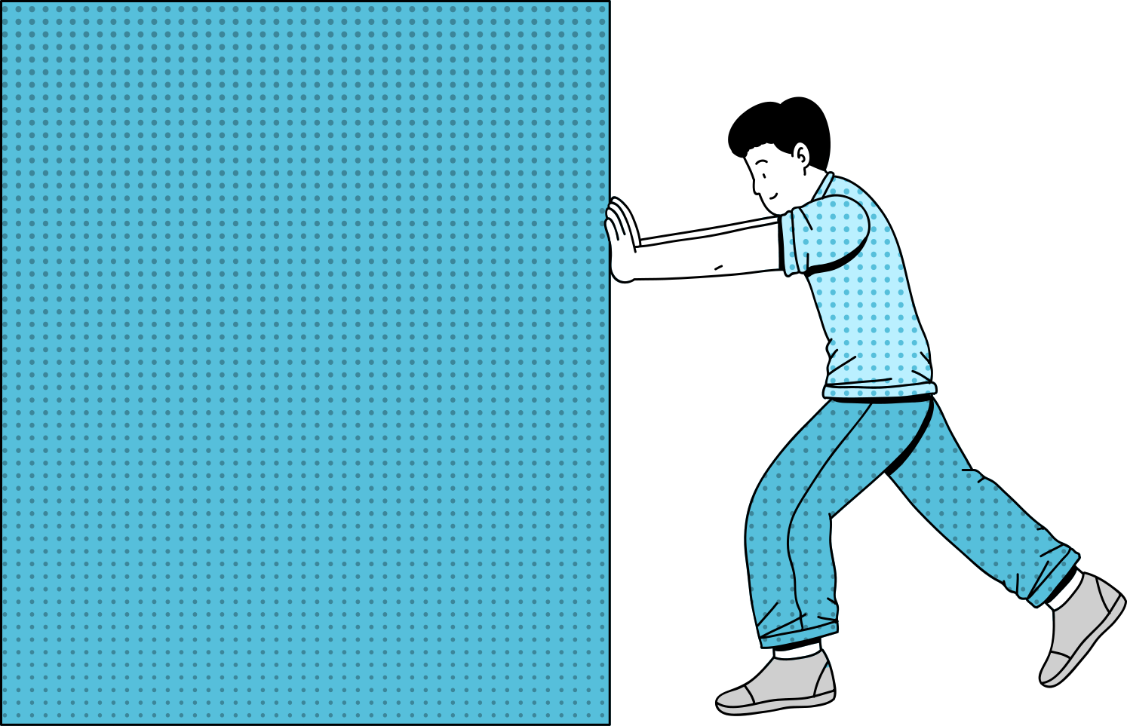




Practical Examples of Stack Operations
Push Function Implementation
Adds a car to the stack, checking for overflow conditions.
Pop Function Implementation
Removes a car from the stack, checking for underflow conditions.
Foundation for Parking Management
These snippets serve as a basis for smart parking system programming.
Error Handling in Stack Operations
Includes messages for stack overflow and underflow scenarios.

Slide 9
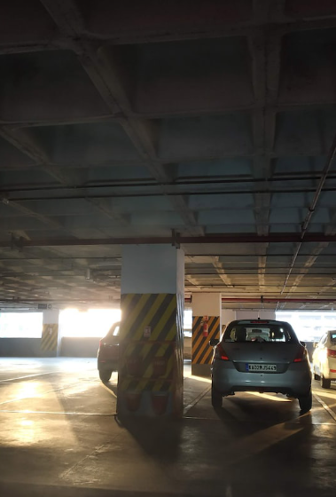


Future Enhancements for Parking Systems
Integration with AI
Using AI for predictive analytics improves space utilization and enhances user experience.
Mobile App Features
Expanding app capabilities to include navigation to available spots streamlines parking.
Payment Automation
Implementing contactless payment systems reduces transaction times and enhances convenience.
User Feedback Incorporation
A feedback system helps improve service and adapts to user needs effectively.

Slide 10
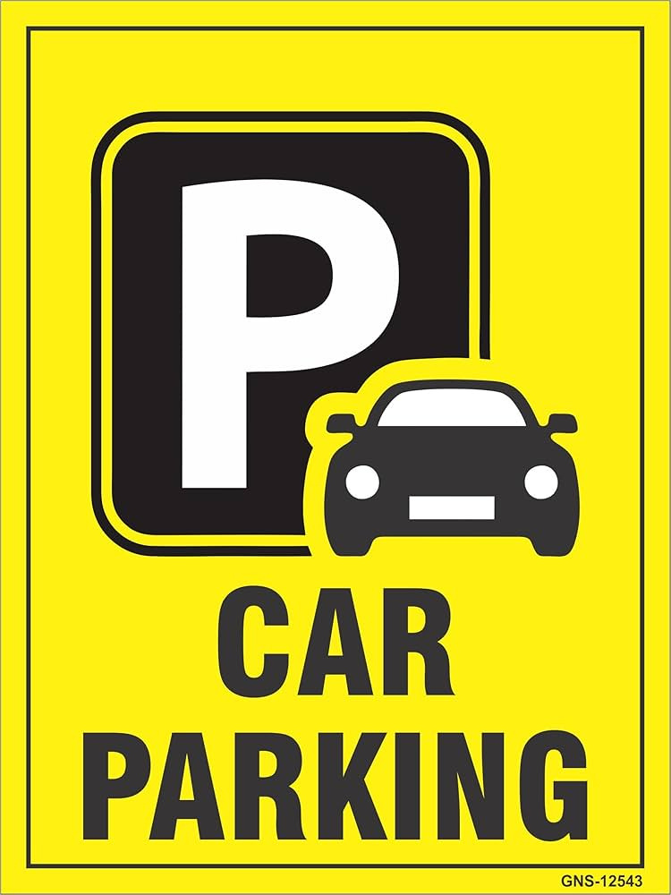
🔚 Conclusion
Shows real-world use of Stack (LIFO) in parking management.
Helps understand stack operations and data flow in C.
🎓 Presented By
Name: Vinayak Khanna
UID: 24BCD10040
Section & Group: 24BCD 1 (B)

